Slide 1
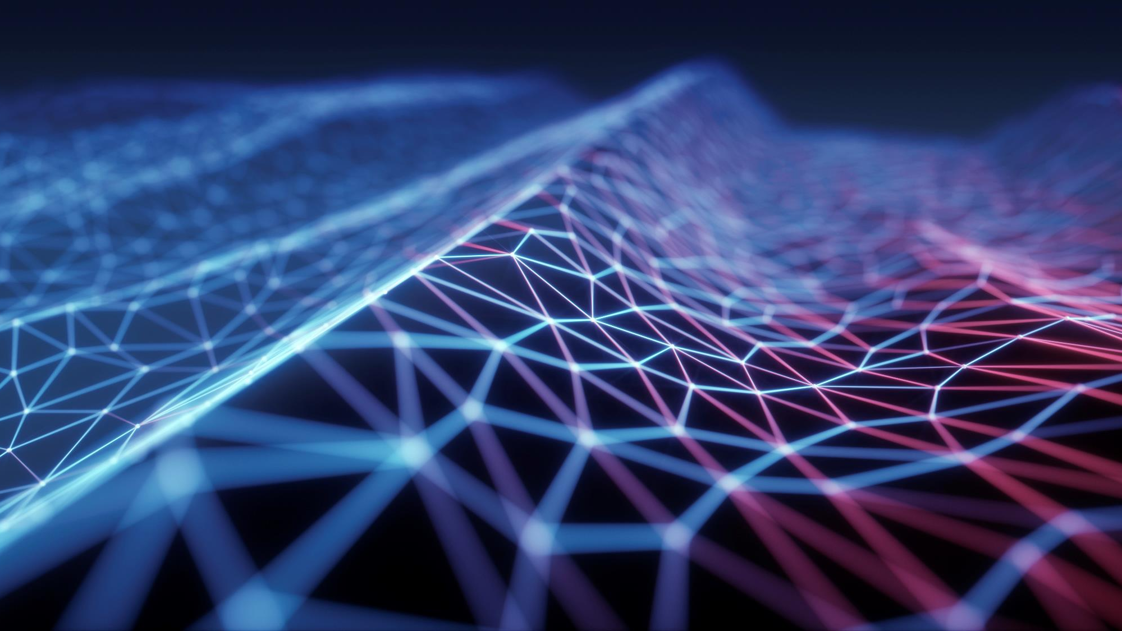
DEPLOYMENT OF
IMAGE DRIVEN TALKING HEAD
GROUP 13

Slide 2
TEAM MEMBERS
L. Srujitha Gali – 801307126
Sai Vignesh Ramisetty- 801282784
Mahija Shivani Dadisetty – 801308384
Poornima Pulkanandam - 801263499

Slide 3
INTRODUCTION
Computer communication and networking have revolutionized the way people communicate with each other, and one of the most interesting areas of research is the development of talking heads that can mimic human expressions and movements.
In this project, we aimed to deploy an image-driven talking head using WebRTC, a real-time communication protocol that enables peer-to-peer communication between web browsers.

Slide 4
MILESTONES
INTEGRATING THE MODEL AND WEB INTERFACE
SETTING UP ENVIRONMENT
DESIGNING WEB INTERFACE
DEPLOYMENT
UNDERSTANDING ML MODEL

Slide 5
REQUIREMENTS
Nvidia GPU (mandatory for CUDA libraries)
All the libraries listed in requirements.txt file
Other extra libraries ( Ktinker, flask, etc...)
Pytorch latest version (for torch vision)
Linux is optional BUT RECOMENDED
Python version 3.9 along with pip

Slide 6
DEPLOYMENT AND IMPLEMENTATION
INTEGRATING THE ML MODEL AND WEB INTERFACE
ENVIROMENT SETUP
DEPVELOPING A WEB INTERFACE
OUTPUT
RECTIFYING ERRORS
CHECKING THE TRAINED MODEL

Slide 7
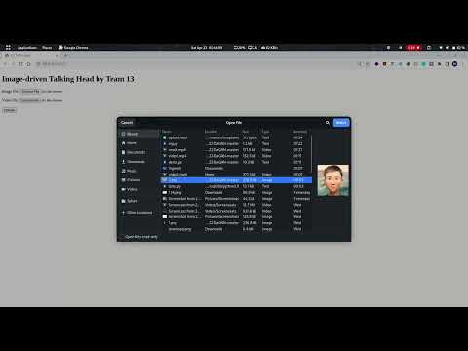
FINAL DEMONSTRATION VIDEO

Slide 8
FINAL DEMONSTRATION LINK
https://youtu.be/942Altmj4fI

Slide 9

CHALLENGES FACED
Lack of experience with deployment
We had to switch between three different PCs
Main challenge is finding out that the model only runs with the help of nvidia GPU and CUDA libraries.
Developing a web-based interface was another significant challenge that required a lot of time and effort.

Slide 10
CONCLUSION
Using WebRTC we have successfully achieved its goal of creating a web interface that can generate a talking head in response to a driving image or video and transmit the output in real-time to a web browser.
The project demonstrates the potential of using computer communication and networking to enhance human interaction and create more realistic virtual environments.

Slide 11

Thank You

